Slide 1
Windows Logs and Sysmon
Incident Response

Slide 2
Windows Event Logs
The logging mechanism built into Windows systems
Logs from the operating system
Logs from applications on the system
Useful for troubleshooting problems
Also useful for detecting security issues
Errors
Warnings
Informational messages

Slide 3
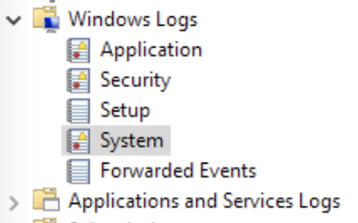
Major logs
Application log
Information about applications
System
System component events
Driver issues, hardware issues…
Security
Resource use
Logins/logoffs
File access
Also will find a lot under Applications and Services Logs

Slide 4
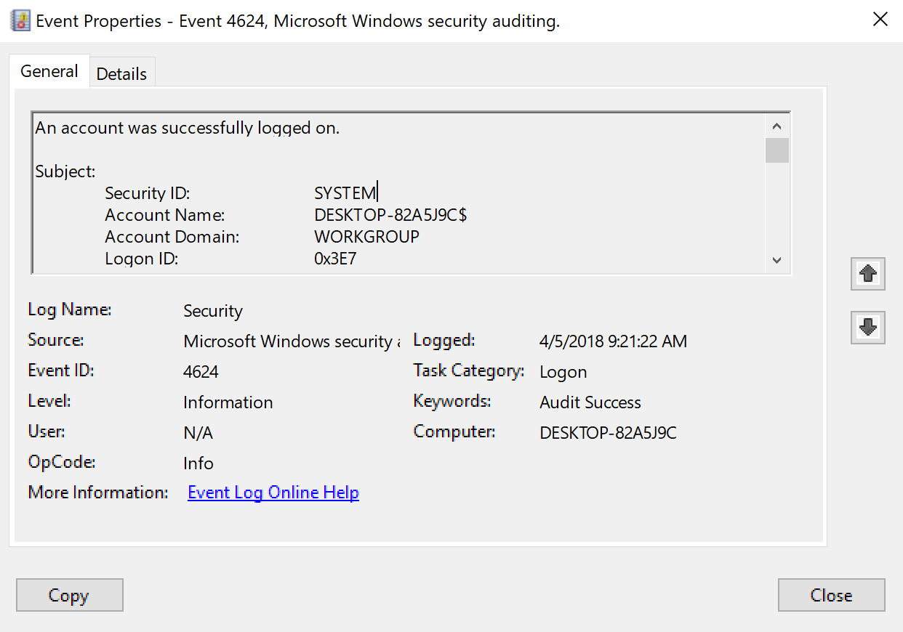
Structure of a Windows Event Log
Event Viewer
Log Name
Application, System, Security, etc.
Event ID
Unique number corresponding with the specific log type
Log Level
Information, Warning, Error
Message
This will vary quite a bit based on the content of the message

Slide 5
“Sexy Six” event logs
4688/592 (Security) – New Process executed
Malware or malicious software running, or malicious actor running things
Not every new process is bad!!
Nmap.exe, ssh.exe, psexec.exe, psexecsvc.exe, ping.exe, powershell.exe, etc…
4624/528/540 (Security) – Account logged in
Attacker logged in
But not all logins are attackers!
4625 – Failed logon attempt
5140/560 (Security) – A share was accessed
Accessing another computer
Lateral movement

Slide 6
“Sexy Six” event logs
5156 (Security) – Windows Firewall Network connection by process
See a process making a connection
Command and control maybe?
7045/601 (System) – New Service installed
New services generally should only be installed during patches and new software installation
Change management procedures – helps anomalies stand out
4663/567 (Security) – File and Registry auditing
Modifications to the system
Files added
Must enable file auditing

Slide 7
Some additional logs
4720 (Security) – A user account was created
Attackers could create themselves an account as a backdoor
Should be fairly easy to deconflict with the admin team
4732/4728 (Security) - A member was added to a group
Attackers could add their account to a higher privileged account
Should be fairly easy to deconflict with the admin team

Slide 8
Logon Types
You’ll find these in logon events
Most common…
2 – Logon via console
3 – Network logon
4 – Batch logon
5 – Windows service logon
10 – Remote interactive logon (RDP)

Slide 9
Process Auditing
So not everything being audited in 4688 by default…
gpedit.msc
Computer Configuration -> Windows Settings -> Security Settings -> Advanced Audit Policy Configuration -> System Audit Policies -> Detailed Tracking
Audit Process Creation

Slide 10
Enable Command Line Auditing
gpedit.msc
Computer Configuration -> Administrative Templates -> System -> Audit Process Creation
Include command line in process creation events
Enable

Slide 11
Sysmon
Monitors and logs system activities to the Windows Event Log
Free!
A part of the Sysinternals Suite
Created by Mark Russinovich
Windows service and driver
Monitoring + logging only – no analysis
Up to you + another tool to do that

Slide 12
Sysmon Event IDs
1 – Process creation
2 – A process changed a file creation time
3 – Network connection
4 – Sysmon service state changed (sysmon was started or stopped)
5 – Process terminated
6 – Driver loaded
7 – Image loaded (module is loaded in a process)
11 – FileCreate
12 – Registry Event (Create and Delete)
Full list here: https://docs.microsoft.com/en-us/sysinternals/downloads/sysmon

Slide 13
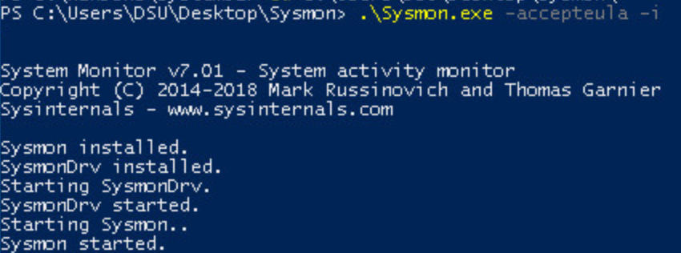
Installing Sysmon
Default settings…
process images hashed with sha1 and no network monitoring
Will for sure want to modify this
Sysmon.exe -accepteula –i
Must install as an admin, since you are installing a service

Slide 14
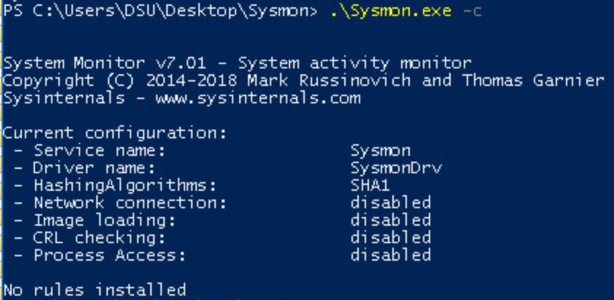
Default Configuration
Sysmon.exe –c
Gets current configuration
Not a whole lot there…

Slide 15
Filtering
We can configure Sysmon to
Only show us certain events (include)
Filter out certain events (exclude)
Do I care to see every smss.exe event?
Is it malicious?
Probably not…
But make sure you only filter out the OFFICIAL path/executable!
Session Manager Subsystem – it’s normal.
XML configuration file
Include events that match…
Exclude events that match…

Slide 16
Sample Configuration File
Network
Only connections on ports 80 and 443 not from Internet Explorer
Drivers
Exclude “Microsoft”
Exclude “windows”
No process termination events

Slide 17
Filtering doesn’t sound fun…
How about a place to start?!?
SwiftOnSecurity Sysmon Configuration
https://github.com/SwiftOnSecurity/sysmon-config
A good baseline to begin from
800+ lines
It’s long
But it’s good
Tweak for your own organization

Slide 18
Tweaking the Config
Logging EVERYTHING will get noisy
Think tons of events on thousands of computers in a large organization
Too much data to deal with
Don’t want to exclude things that could be malicious
Please – read through the sample config if you start there
Make sure you understand what you’re doing
Make sure you agree with what it’s doing
Put it in play and see what happens
Some legitimate process making tons of logs on your network? Exclude it.
Afraid you’re not getting a full enough picture of something? Include it.

Slide 19
Windows Processes
There are a bunch of default processes that are always running
You need to know what’s normal
Experience will help with this
Not only normal to all systems, but also normal to your network
Should spotify.exe be running? Do you have policy that should block it?
What normal applications are employees using?
SANS Hunt Evil poster
https://digital-forensics.sans.org/media/SANS_Poster_2018_Hunt_Evil_FINAL.pdf

Slide 20
Labs – Graylog and Windows Logs
Let’s dive in to some data
Windows 10 machine forwarded data to Graylog
Sysmon
SwiftOnSecurity config, + all network connections logged
Security event log
Start to get familiar with searching and sifting through the available data
Intro Lab
Compromise Investigation lab

